Slide 1

Innopolis University
Control Theory (Linear Control)
Lecture 7
Computed Torque Control (CTC)
Linear Control for Nonlinear Systems
Sergei Savin, PhD
Slides design by Marko Pezer & Artem Bakhanov

Slide 2
Topic of the Lecture
Error Dynamics
Computed Torque Controller (CTC)
Stability of CTC
Linearization of a Nonlinear Dynamics
Control Theory (Linear Control)
Slide 2

Slide 3



Error Dynamics (1/2)
Control error:
$$e=q^{∗}−q$$
Error dynamics:
$$\ddot{e}+K_{d}\dot{e}+K_{p}e=0$$
Robot dynamics:
$$H\ddot{q}+c=Bu$$
Control Theory (Linear Control)
Slide 3

Slide 4
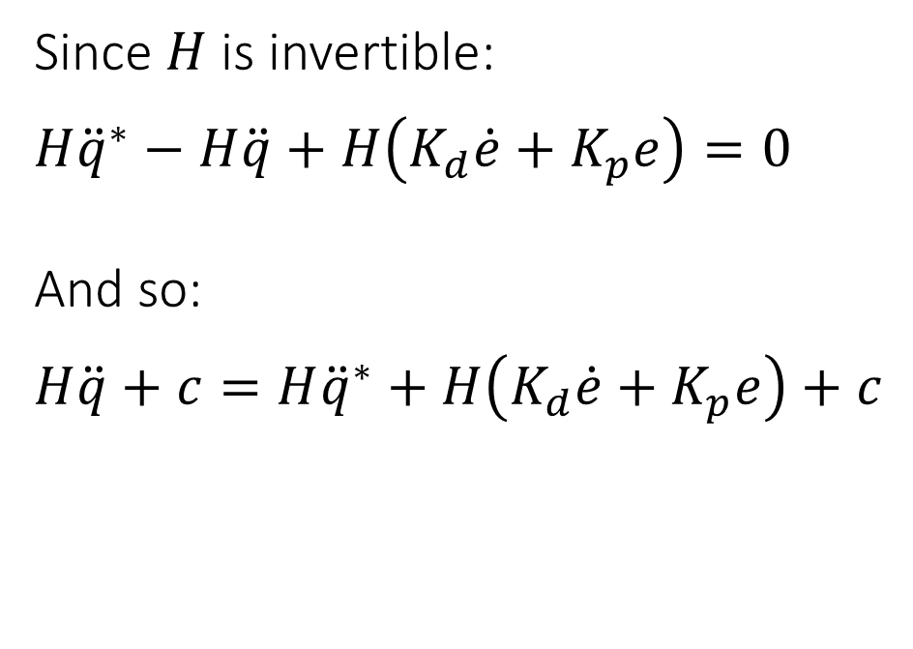

Error Dynamics (2/2)
Error dynamics:
$${\ddot{q}}^{∗}−\ddot{q}+K_{d}\dot{e}+K_{p}e=0$$
Since $H$ is invertible:
$$H{\ddot{q}}^{∗}−H\ddot{q}+H\left(K_{d}\dot{e}+K_{p}e\right)=0$$
And so:
$$H\ddot{q}+c=H{\ddot{q}}^{∗}+H\left(K_{d}\dot{e}+K_{p}e\right)+c$$
Control Theory (Linear Control)
Slide 4

Slide 5

Computed Torque Controller (CTC) (1/3)
Since $H\ddot{q}+c=Bu$:
$$Bu=H{\ddot{q}}^{∗}+H\left(K_{d}\dot{e}+K_{p}e\right)+c$$
And so:
$$u=B^{+}\left(H{\ddot{q}}^{∗}+c\right)+B^{+}H(K_{d}\dot{e}+K_{p}e)$$
Control Theory (Linear Control)
Slide 5

Slide 6

Computed Torque Controller (CTC) (2/3)
CTC controller:
$$u=B^{+}\left(H{\ddot{q}}^{∗}+c\right)+B^{+}H(K_{d}\dot{e}+K_{p}e)$$
Feedback part:
$$u_{FB}=B^{+}H(K_{d}\dot{e}+K_{p}e)$$
Feedforward part:
$$u_{FF}=B^{+}\left(H{\ddot{q}}^{∗}+c\right)$$
Control Theory (Linear Control)
Slide 6

Slide 7

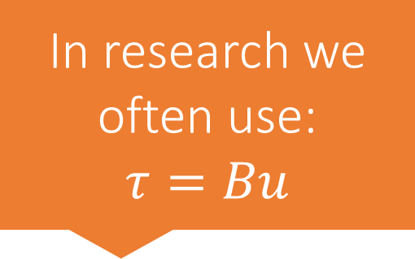
Computed Torque Controller (CTC) (3/3)
CTC controller:
$$τ=\left(H{\ddot{q}}^{∗}+c\right)+H(K_{d}\dot{e}+K_{p}e)$$
Feedback part:
$$τ_{FB}=H(K_{d}\dot{e}+K_{p}e)$$
Feedforward part:
$$τ_{FF}=H{\ddot{q}}^{∗}+c$$
In research we
often use:
$$τ=Bu$$
Control Theory (Linear Control)
Slide 7

Slide 8

Stability of CTC
Remember that $\ddot{e}+K_{d}\dot{e}+K_{p}e=0$
Then $K_{d}$ and $K_{p}$ are diagonal, then,
if $K_{d}$ and $K_{p}$ are negative definite,
the error is stable.
Control Theory (Linear Control)
Slide 8

Slide 9
How to find CTC coefficients using LQR?
Control Theory (Linear Control)
Slide 9

Slide 10
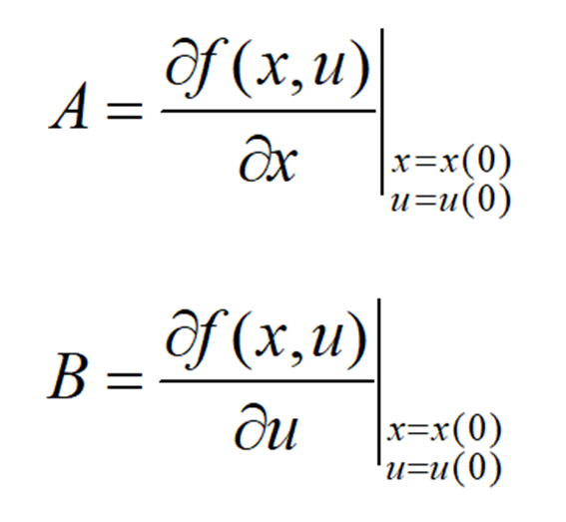

Linearization of a Nonlinear Dynamics (1/2)
Nonlinear system: $\dot{x}=f\left(x,u\right)$
Simple linearization:
Control Theory (Linear Control)
Slide 10

Slide 11
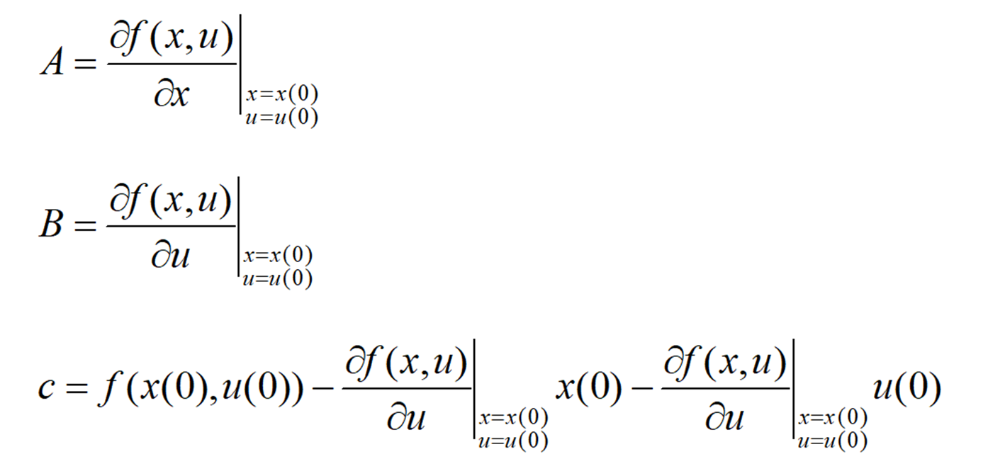
Linearization of a Nonlinear Dynamics (2/2)
If the dynamics is affine:
Control Theory (Linear Control)
Slide 11

Slide 12
The End
Do you have any questions?

